Slide 1
SUMMER INTERNSHIP REPORT
AKASH S
INFORMATION TECHNOLOGY

Slide 2
Table Of Contents
➢Introduction
● Linear regression using Machine learning
● Hypothesis function for Linear Regression
➢Problem
● Understanding the Problem Statement
● k-Nearest Neighbours
● Solutions
Conclusion
References

Slide 3
Stock Prices Prediction Using Machine Learning and Deep Learning Techniques (with Python codes)

Slide 4
Introduction
Linear Regression Using Machine Learning
Linear regression is one of the easiest and most popular Machine Learning algorithms. It is a statistical method that is used for predictive analysis.
Regression makes predictions for continuous/real or numeric variables such as sales , salary, age, product price etc.
Linear Regression is a machine learning algorithm based on supervised learning. It performs a regression task.

Slide 5
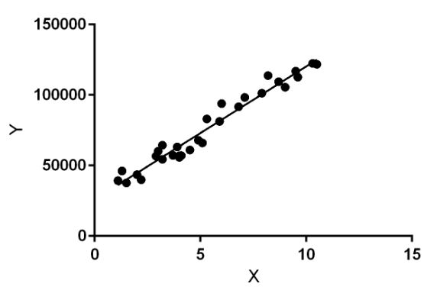
Linear regression
Figure. 1 [2]
In the figure above, X (input) is the work experience and Y a(output) is the salary of a person. The regression line is the best fit line for our model

Slide 6

Hypothesis function for Linear Regression :[2]
(1)
While training the model we are given :
x:input training data (univariate – one input variable(parameter)) y:labels to data (supervised learning) When training the model – it fits the best line to predict the value of y for a given value of x.
The model gets the best regression fit line by finding the best θ1 and θ2 values.
θ1:intercept
θ2:coefficient of x

Slide 7
Problem
Understanding the Problem Statement
Problem - Predict the stock market price of next few days using previous stock market data (equity or indices) using machine learning or Deep learning.
1. Use News headlines as Data for prediction.
2. Use previous Equity data of Day open, close, low , high for prediction.
3. Any other stock Relative data. Note: Try to improve the accuracy of the previously built model or implement it from scratch

Slide 8
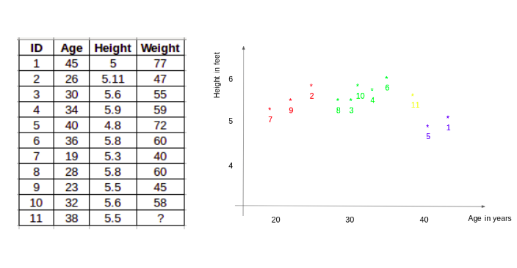
k-Nearest Neighbours
Another interesting ML algorithm that one can use here is kNN (k nearest neighbours). Based on the independent variables, kNN finds the similarity between new data points and old data points. Let me explain this with a simple example.
Consider the height and age for 11 people. On the basis of given features(‘Age ’and ‘Height’), the table can be represented in a graphical format as shown below
Table .1 [2]
Figure. 2 [1]

Slide 9
Solution
From the given dataset the following predictions
Google Colab Link:
https://colab.research.google.com/drive/1oiBOEeYGQ6-kAkPAiGTqWkoGtjyqNCPz?usp=sharing
Python source codes for stock prediction:
#import packages
import pandas as pd
import numpy as np

Slide 10
#to plot within notebook
import matplotlib.pyplot as plt
%matplotlib inline
#setting figure size
from matplotlib.pylab import rcParams
rcParams['figure.figsize'] = 20,10
#for normalizing data
from sklearn.preprocessing import MinMaxScaler
scaler = MinMaxScaler(feature_range=(0, 1))
from google.colab import files
uploaded=files.upload()
#setting index as date
df['Date'] = pd.to_datetime(df.Date,format='%Y-%m-%d')
df.index = df['Date']
#plot
plt.figure(figsize=(16,8))
plt.plot(df['Close'], label='Close Price history')

Slide 11
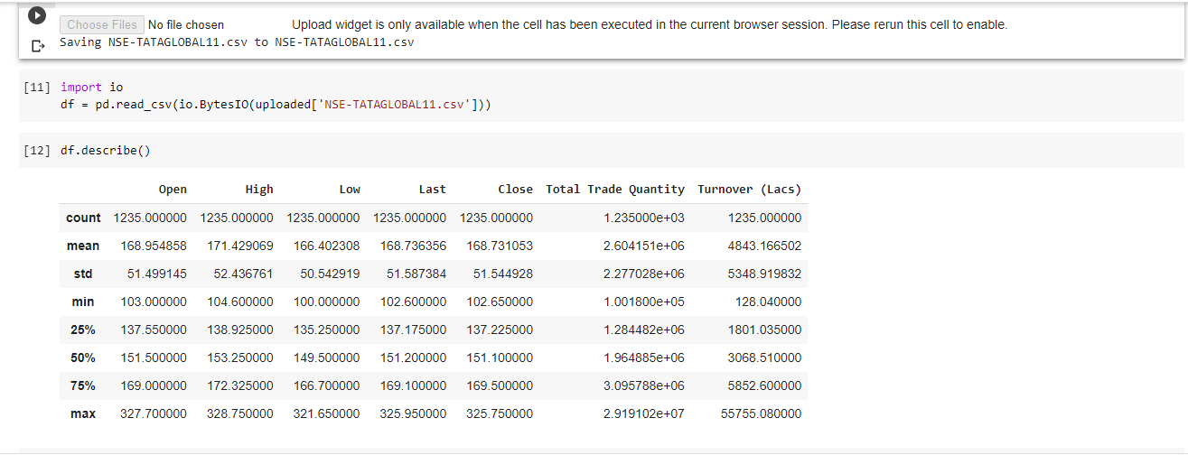
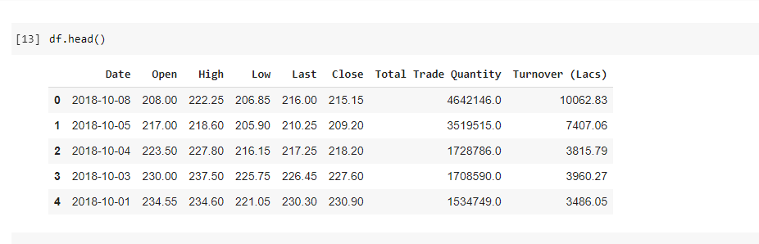
Figure 3 Describe the given data set.[3]
Figure . 4 Head of the data set. Reference [givendata set]

Slide 12
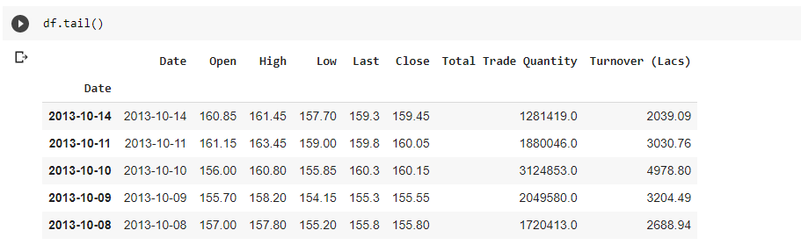
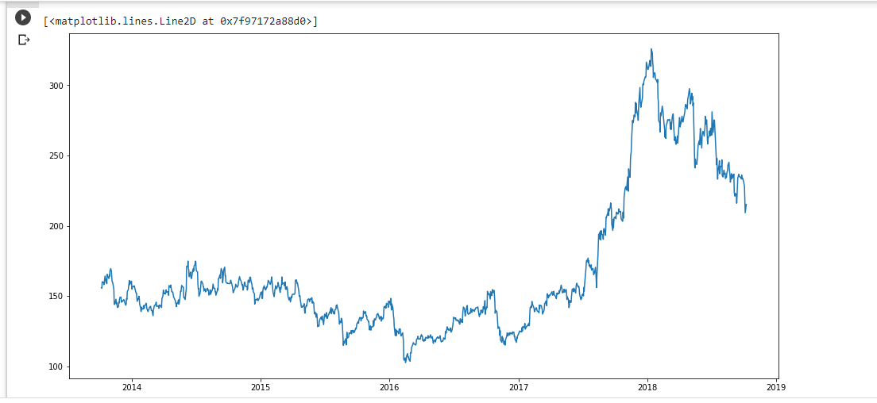
Figure 5 Tail of the dataset. Reference [given data set]
Figure 6 price history. Reference[ colab link]

Slide 13
# setting the index as date
df['Date'] = pd.to_datetime(df.Date,format='%Y-%m-%d')
df.index = df['Date']
#creating dataframe with date and the target variable
data = df.sort_index(ascending=True, axis=0)
new_data = pd.DataFrame(index=range(0,len(df)),columns=['Date', 'Close'])
for i in range(0,len(data)):
new_data['Date'][i] = data['Date'][i]
new_data['Close'][i] = data['Close'][i]
# splitting into train and validation
train = new_data[:987]
valid = new_data[987:]
x_train.shape
(987, 1)
# making predictions
preds = []
for i in range(0,valid.shape[0]):
a = train['Close'][len(train)-248+i:].sum() + sum(preds)
b = a/248
preds.append(b)

Slide 14
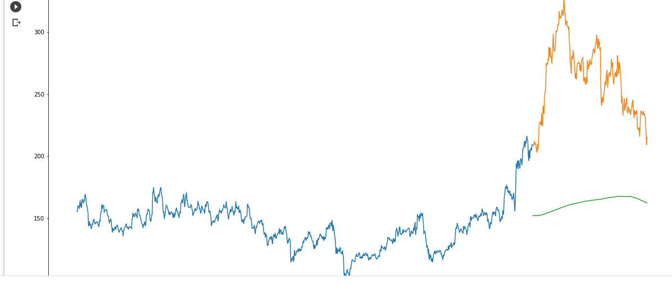
#plot
valid['Predictions'] = 0
valid['Predictions'] = preds
plt.plot(train['Close'])
plt.plot(valid[['Close', 'Predictions']])
Figure 7 close prediction. Reference [colab link]

Slide 15
#setting index as date values
df['Date'] = pd.to_datetime(df.Date,format='%Y-%m-%d')
df.index = df['Date']
#sorting
data = df.sort_index(ascending=True, axis=0)
#creating a separate dataset
new_data = pd.DataFrame(index=range(0,len(df)),columns=['Date', 'Close'])
for i in range(0,len(data)):
new_data['Date'][i] = data['Date'][i]
new_data['Close'][i] = data['Close'][i]
# checking the results (RMSE value)
rms=np.sqrt(np.mean(np.power((np.array(valid['Close'])-preds),2)))
print('\n RMSE value on validation set:')
print(rms)
RMSE value on validation set:
104.51415465984348

Slide 16


Result:
Final predictions and accuracy is..
RMSE value on validation set: 104.51415465984348
Formula using for this machine learning:[2]
(2)
(3)

Slide 17
References:
1 . https://towardsdatascience.com/machine-learning-techniques-applied-to-stock-price-prediction-6c1994da8001
2 . https://www.geeksforgeeks.org/ml-linear-regression/
3 . https://www.analyticsvidhya.com/blog/2018/10/predicting-stock-price-machine-learningnd-deep-learning-techniques-python/
4.https://www.researchgate.net/publication/331345883_Stock_Market_Prediction_Using_Machine_Learning/link/5cb4487a299bf120976663be/download
5 .https://data-flair.training/blogs/stock-price-prediction-machine-learning-project-in-python/

Slide 18
Thank you...

